Slide 1

Finding Waldo
Timothy J Cain

Slide 2
Dataset
Found online on Kaggle:
Includes:
Original Size
64x64 rgb, bw, gray split into waldo and not waldo
128x128 rgb, bw, gray split into waldo and not waldo
256x256 rgb, bw, gray split into waldo and not waldo
Link:
https://www.kaggle.com/datasets/residentmario/wheres-waldo

Slide 3
Initial Design
2 classes: [“notwaldo”, ”waldo”]
Convolutional Neural Network:
2D Convolutional layer: 32 filters, kernel size=3, no padding, activation function=Relu
Pooling Layer: 2 x 2
2D Convolutional layer: 64 filters, kernel size=3, no padding, activation function=Relu
Pooling Layer: 2 x 2
Flatten Layer
Dense Layer: 128 nodes, activation function=Relu
Dense Layer: 2 softmax outputs (either waldo, or not waldo)

Slide 4
Initial Design
Train CNN:
5000 64x64 images of not waldo and
27 64x64 images of waldo
Test CNN by segmenting full image into 64x64 tiles and pass each tile through the CNN
The output is a tuple of confidence values for notwaldo and waldo

Slide 5
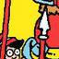
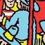
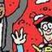
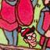

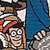
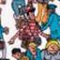
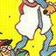
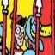
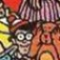
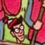
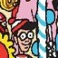
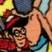
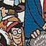
Pitfalls
Every Training Picture of Waldo is Different:
Different resolution
Waldo is further away or closer
Some images cut off Waldo
Training images:

Slide 6
Pitfalls
Class imbalance:
5000 images of notwaldo
27 images of waldo
Two approaches:
Oversample Waldo
Undersample Not Waldo

Slide 7
First Version
It Didn’t Work. Why?
Class imbalance
Too much variance in the training data for Waldo
Needed to resize original image so it could be split evenly
Changed size and resolution of Waldo

Slide 8
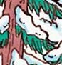
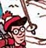
Proof of concept
To verify that my CNN was learning what Waldo looks like.
Retrain model with smaller dataset:
100 images of not waldo
47 images of waldo
Test Images:
Not waldo:
Waldo:

Slide 9
Results
Not Waldo Test image:
Scores:
Not Waldo Confidence: 100%
Waldo Confidence: 0%
Waldo Test Image:
Scores:
Not Waldo Confidence: 9.462098e-8%
Waldo Confidence: 100%

Slide 10
What I Learned
Image Processing has a lot of factors that make it difficult.
Class Imbalance can greatly affect your output

Slide 11
Thank you

